Slide 1
Excretory System
Year 11 Human Biology
ATAR
PowerPoint 13

Slide 2
SCSA Syllabus Reference
the excretory system regulates the chemical composition of body fluids by removing metabolic wastes and retaining the proper amounts of water, salts, and nutrients; components of this system include the kidneys, liver, lungs, and skin functioning at the organ level
deamination of amino acids in the liver produces urea, which then is transported to the kidneys for removal
the nephrons in the kidney facilitate three basic processes: filtration, reabsorption and secretion during urine formation to maintain the composition of body fluids (hormone control is not required)

Slide 3
Lesson Intention
To explore the structure and function of the excretory system
To explore the structure and function of the kidneys
To explore the effects of lifestyle on excretion

Slide 4
Success Criteria
define excretion
identify the components of the excretory system
describe the structure of the excretory system
describe the function of the excretory system
describe the process of deamination
describe the structure of the kidneys
describe the function of the kidneys
describe the structure of nephrons
explain the process of urine production (glomerular filtration, reabsorption, tubular secretion)
describe the composition of urine

Slide 5
Success Criteria
describe the cause, effects and treatment of kidney stones
explain the process of dialysis
explain why dialysis is needed
describe the cause, effects and treatment of liver disease

Slide 6
Vocabulary
Excretion: removal of wasters of metabolism from the body
Lung: one of a pair of organs for gas exchange, occupying the chest cavity
Liver: organ that is part of the excretory system
Sweat glands: tubular structures in the skin that produce sweat

Slide 7
Vocabulary
Kidneys: the principal excretory organs of the human body; they filter waste from the blood and regulate the balance of water and salts in the blood plasma
Deamination: the removal of the amino group from an amino acid molecule
Renal capsule: a tough fibrous layer surrounding the kidney
Nephron: the functional unit of the kidney

Slide 8
Vocabulary
Collecting duct: the tube in the kidney that collects filtrate from several nephrons
Glomerulus: the tightly coiled mass of capillaries that is surrounded by the expanded part of each kidney tubule.
Loop of Henle: The U-shaped section of the kidney tubule; it plays a major role in the reabsorption of water and salts from the filtrate
Ureter: the tube that leaves each kidney and drains into the urinary bladder

Slide 9
Vocabulary
Afferent arterioles: the blood vessel that enters an organ
Efferent arterioles: the blood vessel that leaves a glomerulus in the kidney
Glomerular filtration: the filtration of blood in the kidney
Filtrate: the fluid remaining after filtration has taken place

Slide 10
Vocabulary
Selective reabsorption: the reabsorption of some substances and not others in the renal tubules
Tubular secretion: the process whereby ions and drugs are secreted from the blood into the kidney tubule
Uric acid: a breakdown product of the metabolism of purines such as the bases adenine and guanine found in DNA and RNA
Creatinine: a waste product from the breakdown of muscles

Slide 11
Vocabulary
Kidney stones: solid masses of crystals that develop within the kidneys
Kidney failure: occurs when the kidneys lose their ability to excrete wastes and control the level of fluid in the body
Dialysis: a method of removing waste from the blood when kidney failure occurs

Slide 12
Vocabulary
Peritoneum: the membrane that lines the inside of the abdominal cavity
Peritoneal dialysis: dialysis occurring inside the body, using the peritoneum as the membrane across which wastes can be removed
Haemodialysis: process in which blood is passed through an artificial kidney or dialysis machine

Slide 13
Waste Removal Organs
Lungs- excrete carbon dioxide
Liver- processes substances for excretion
Sweat glands- secrete sweat containing by-products of metabolism such as salts, urea and lactic acid
Alimentary canal- bile pigments
Kidneys- primary excretory organs that remove nitrogenous wastes and maintain concentration levels of bodily fluids

Slide 14
Liver
Proteins are primarily ‘body builders’, that is, they make up the structural materials of cells. As long as the body has a sufficient supply of carbohydrates and fats, then little protein is used in energy-releasing reactions.
Excess proteins is unable to be stored and must be removed.

Slide 15
Liver continued.
The proteins, which have been built up from amino acids, become the primary constituents of cell structures, enzymes, antibodies and many glandular secretions.
To use proteins to produce energy, the amino group must first be removed from the amino acids. This process, called deamination, occurs in the liver with the aid of enzymes. Once the amino group is gone, it is converted by the liver to ammonia and then to urea.
Urea is eliminated from the body in urine. With the remaining part of the amino acid converted into a carbohydrate for energy.

Slide 16
Deamination
enzymes
Amino acid + oxygen → carbohydrate and ammonia

Slide 17
Ammonia
Extremely soluble in water
Highly toxic
Liver cells rapidly convert ammonia to urea, which is easily excreted by the kidneys and as sweat from sweat glands.
Energy + carbon dioxide + ammonia → urea + water

Slide 18
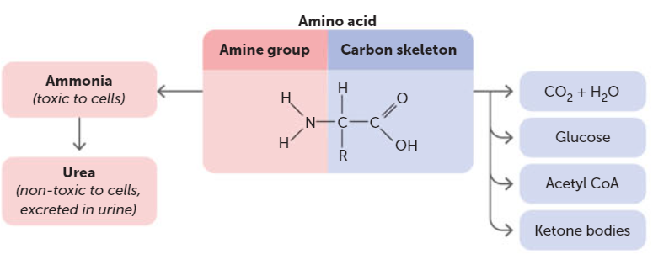

Slide 19
Liver continued
Detoxifies alcohol and many other drugs e.g. antibiotics
Deactivates many hormones and converts them into a form that can be excreted by the kidneys
Breaks down haemoglobin from dead red blood cells to produce bile pigments, which are then passed out of the body with the faeces.

Slide 20
Skin
Main function- protective covering over the surface of the body and to regulate body temperature.
Even when there is no visible perspiration on the skin, the sweat glands secrete about 500 mL of water per day. Sweat glands are located in the lower layers of the skin, a duct carries the sweat to a hair follicle or skin surface where it opens at a pore.
In that water is dissolved salt, lactic acid and urea.

Slide 21
The Kidneys
Pair of reddish brown organs located in the abdomen.
The kidneys, bladder and their associated ducts are often referred to as the urinary system.

Slide 22
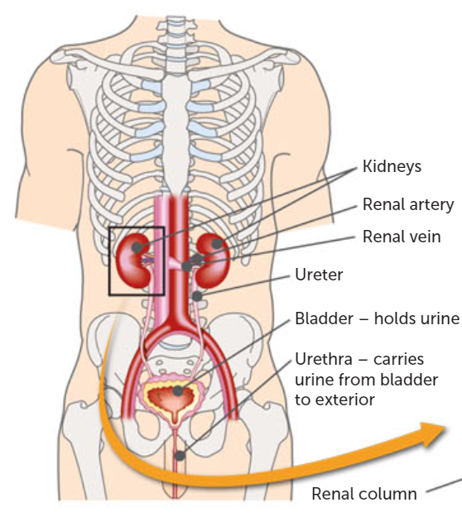

Slide 23
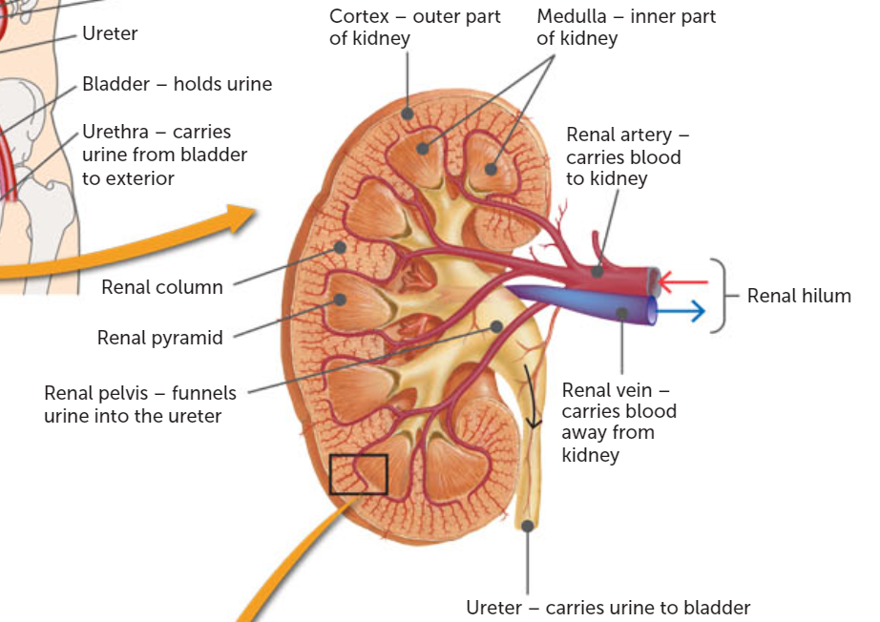

Slide 24
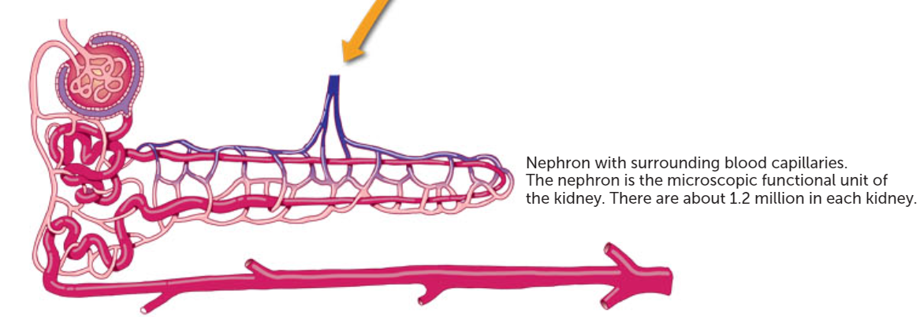

Slide 25
Kidney continued
The kidney is enclosed by the renal capsule. Under this is the outer renal cortex, the inner renal medulla, and then the renal pelvis sits in the concave side of the kidney.
The renal hilum lies on the concave surface of the kidney, and is where the vessels enter and leave. The medulla consists of a number of renal pyramids, which are separated by renal columns, where the blood vessels lie.
*so many renals (sigh)

Slide 26
Nephrons
The kidney is composed of a large number of structures called nephrons and collecting ducts.
The nephron is the functional unit of the kidney, as it is where the urine is formed. There are about 1.2 million nephrons in each human kidney, and each is surrounded by a complex network of blood capillaries.

Slide 27
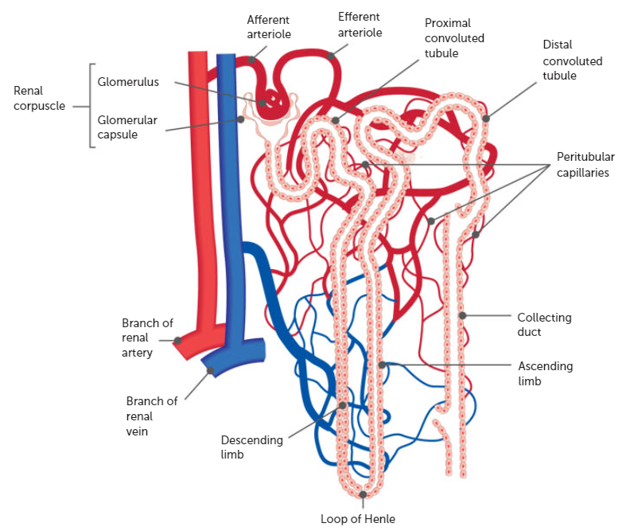

Slide 28
Nephron continued.
Each nephron consists of a renal corpuscle and a renal tubule.
The renal corpuscle consists of the glomerulus and the glomerular capsule (used to be called Bowman’s capsule) is the expanded end of the nephron.
It looks like a double-walled cup that surrounds, and almost completely encloses, a knot of arterial capillaries called the glomerulus.

Slide 29
Nephron continued
Leading away from the glomerular capsule is the renal tubule. It begins with a winding, or convoluted, section called the proximal convoluted, section called the proximal convoluted tubule.
Beyond this, each tubule has a straight portion before it forms a loop, the loop of Henle. The loop of Henle is like a hairpin bend, with a straight section leading into the bend and another straight section leading away from the bend.

Slide 30
Nephron continued
The tubule then becomes convoluted and highly coiled again. This second coiled second is known as the distal convoluted tubule. This joins into a collecting duct that opens into a chamber in the kidney called the renal pelvis.
The renal pelvis is shaped like a funnel and channels fluid from the collecting ducts into the ureter.

Slide 31
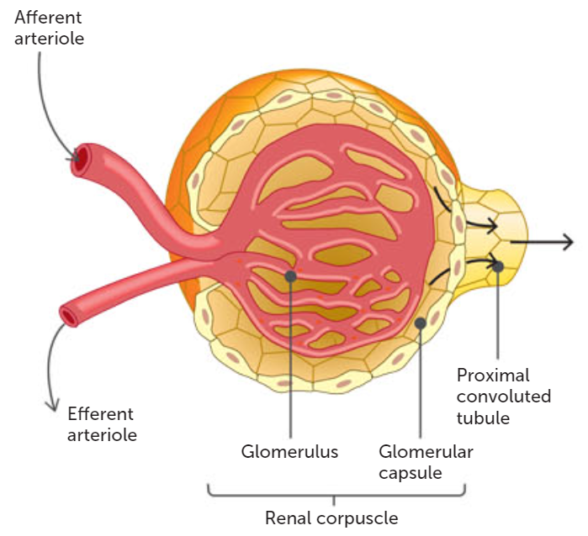

Slide 32
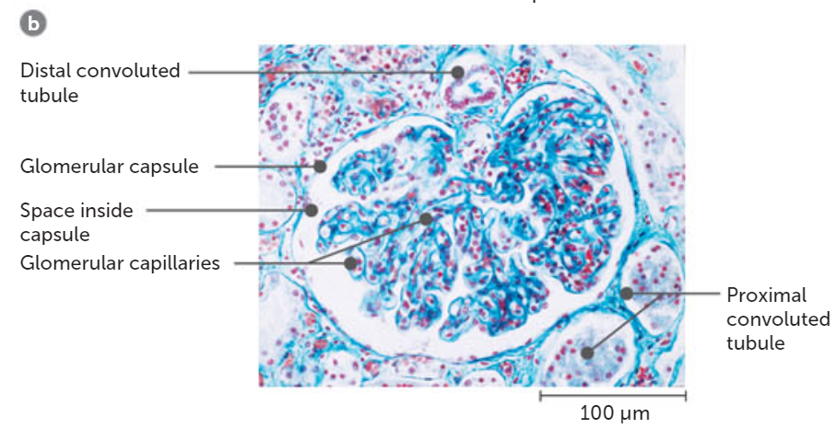

Slide 33
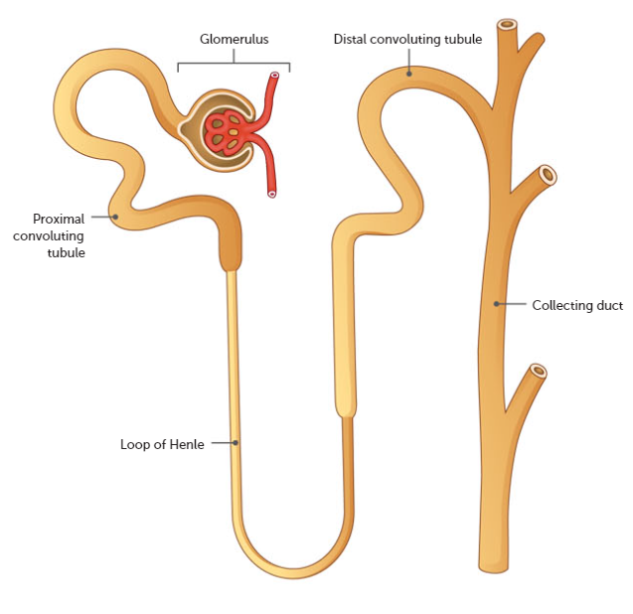

Slide 34
Nephrons continued.
The nephrons of the kidney are responsible for removing wastes from the blood and regulating blood composition.
To be able to this, they are well supplied with blood vessels. Blood enters the kidney through the renal arteries.
These arteries are quite large. They are able to pass 1.2 L of blood every minute.

Slide 35
Nephrons continued.
After entering the kidney, the renal artery divides into small arteries and arterioles. Each renal corpuscle is supplied by an afferent arteriole, which then forms a knot of capillaries called the glomerulus.
The glomerulus is located within the glomerular capsule. The capillaries unite to form another arteriole called the efferent arteriole, which passes out of the renal corpuscle.

Slide 36
Nephrons continued
After leaving the renal corpuscle, the efferent arteriole breaks up into a second capillary network. These capillaries surround the proximal and distal convoluted tubules of the nephron, the ascending and descending limbs of the loop of Henle, and the collecting duct.
They are known as peritubular capillaries. Venous blood drains away from this network of capillaries and eventually leaves the kidney in the renal vein.

Slide 37
Key Concept
Blood enters the nephron through the afferent arteriole.
It is filtered in the glomerulus, a network of capillaries
It then exits via the efferent arteriole.

Slide 38
Production of Urine
Involves three major processes
Glomerular filtration
Selective reabsorption
Secretion by the tubules

Slide 39
Glomerular Filtration
Takes place in the renal corpuscle when fluid is forced out of the blood and collected by the glomerular capsule.
The blood in the capillaries in the glomerulus is separated from the cavity of the capsule by only two single layers of thin, flat cells. One layer makes up the capillary wall and the other makes up the capsule wall.

Slide 40
Glomerular Filtration
When blood enters the glomerulus, the high pressure forces water and dissolved blood components through the differentially permeable cell membranes and into the capsule. The resultant fluid is termed the filtrate.
Filtrate consists of all the materials (e.g. water, salts, amino acids, glucose, area, uric acids etc.) present in blood except red and white blood cells and plasma proteins (too big to pass through the membrane).

Slide 41
Glomerular Filtration
As blood flows through the glomerulus, 20% of the plasma is filtered through the capillary walls into the glomerular capsule. Complete filtration of all the plasma cannot take place as the blood is continually moving.
Around 180 L of filtrate is passed every day, with only about 1% actually leaving the body as urine. Most is reabsorbed back into the blood.

Slide 42
Reabsorption
Many of the components of the plasma that are filtered from the capillaries of the glomerulus are of use to the body
Some selective reabsorption of the filtrate must take place, returning them to the blood in the peritubular capillaries. Materials that are reabsorbed include water, glucose, amino acids, sodium ions, calcium ions etc.

Slide 43
Reabsorption continued.
Surface area is important here.
Effective reabsorption of materials is achieved by the long length of the kidney tubule and by the huge numbers of nephrons in each kidney.
Reabsorption of the water in the filtrate can be regulated. This is an active process, under hormonal control.

Slide 44
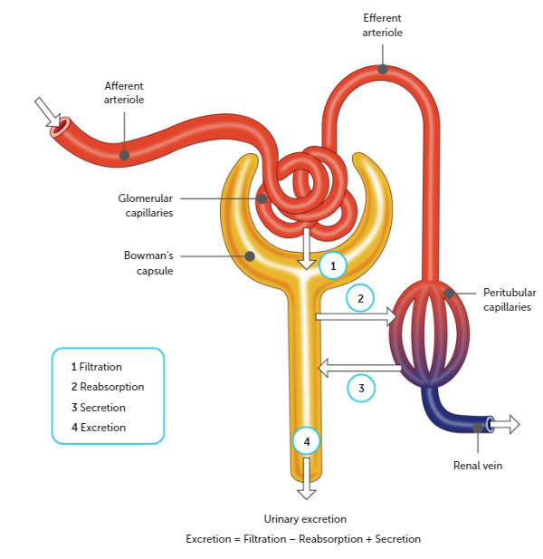

Slide 45
Tubular Secretion
Whereas selective reabsorption removes substances from the filtrate into the blood tubular secretion adds materials to the filtrate from the blood.
Materials secreted in this way include potassium and hydrogen ions, creatinine, and drugs such as penicillin.

Slide 46
Tubular Secretion continued.
Tubular secretion can be either active or passive, and has two main effects
It maintains the blood pH. The body needs to maintain the blood within its normal pH range of 7.4-7.5. Our diet usually contains many acid-producing food that tend to lower pH; therefore, the kidneys must remove the excess hydrogen and ammonium ions.
It maintains the urine pH. The presence of hydrogen and ammonium ions in the urine makes the urine slightly acidic, with a normal pH of 6.

Slide 47
Tubular Secretion continued.
Water and other substances not reabsorbed drain from the collecting ducts into the renal pelvis.
From the pelvis, the urine, drains into the ureters and is pushed by waves of muscle contraction to the urinary bladder where it is stored.
They extend 25-30cm to the urinary bladder. The bladder is a hollow muscular organ from which the urethra exits. The urethra carries urine from the bladder to the exterior of the body.

Slide 48
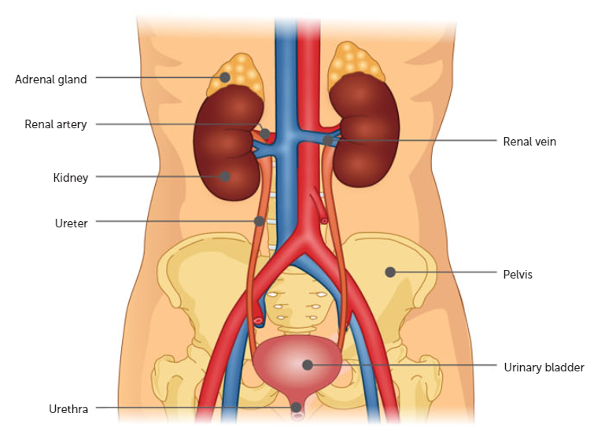

Slide 49
Tubular Secretion continued.
The formation if urine is maximised by the structure of the kidney, particularly the nephron, as follows
The glomerular capsule surrounds the glomerulus to collect the fluid filtered out of the blood capillaries
There are only two cells for the filtrate to pass through from the blood, one cell from the capillary wall and the other from the capsule wall
A large volume of blood passes through each kidney maintaining the concentration gradient
Efferent arteriole leading out of the glomerulus has a smaller diameter than the afferent arteriole leading in, raising the blood pressure so more fluid is filtered out of the blood
Each tubule has a large surface area for reabsorption and secretion due to each tubule having two sets of convolutions and a long loop
Each kidney has over a million nephrons, so the total surface are available for reabsorption and secretion is extremely large

Slide 50
Region of Nephron | Activities taking place
Renal corpuscle | Filtration of blood from capillaries of glomerulus Formation of filtrate in the glomerular capsule
Proximal convoluted tubule and loop of Henle | Passive reabsorption of potassium, chloride and bicarbonate ions Active reabsorption of glucose and sodium Passive reabsorption of water by osmosis
Distal convoluted tubule | Active reabsorption of sodium ions Active reabsorption of water, depending on its needs Secretion of hydrogen and potassium ions, creatinine and certain drugs such as penicillin
Collecting duct | Active reabsorption of water, depending on the body’s water needs

Slide 51
Composition of Urine
Chemical Component | Filtrate | Reabsorbed Substances | Urine
Water | 180 L | 178-9 L | 1-2 L
Sodium, chloride and other ions | 1500 g | 1485 g | 15 g
Proteins | 2 g | 1.9 g | 0.1 g
Glucose | 180 g | 180 g | 0 g
Urea | 53 g | 28 g | 25 g
Uric Acid | 8.5 g | 7.5 g | 1 g
Creatinine | 1.6 g | 0 g | 1.6 g

Slide 52
Composition of urine continued
Uric acid is produced by the metabolism of substances called purines. Purines may come from the breakdown of nucleic acids, such as DNA, when cells die and also occur naturally in many foods.
Creatinine is produced in muscle from the breakdown of creatine phosphate, an energy rich molecule.

Slide 53
Composition of urine continued
Under normal circumstances:
About 99% of the water that enters the nephron is reabsorbed
The urine does not normally contain significant amounts of protein
The urine does not normally contain any glucose
The main materials making up the urine, besides water, are urea, ions, uric acid and creatinine.
A healthy adult produces around 1.5 L of urine a day.

Slide 54
Kidney Stones
Formed from solid crystals that build up inside the kidneys. They usually form when urine becomes too concentrated or from insufficient fluids in the diet.
If they are small enough, they may pass down the ureter and out of the body without notice. Crystals may combine to form stones, with larger ones getting stuck in the ureter, bladder, or urethra, causing intense pain.
Extreme cases may need surgery.

Slide 55
Kidney Failure
1 in 3 adult Australians is at risk of developing kidney disease. A person can lose up to 90% of their kidney function without realising.
Most kidney diseases affect the glomeruli, reducing their ability to filter the blood. Protein and sometimes red blood cells may leave the blood at the glomerulus and will then be present in the urine. This can result in swelling (hands, feet, face)

Slide 56
Kidney failure continued.
There are a number of lifestyle measures that you can take to maintain healthy kidneys
Maintain a healthy weight
Maintain a healthy blood pressure
Do not smoke
Drink water instead of sugary drinks
Drink alcohol in moderation
Do not use performance-enhancing drugs
Eventually the only way to maintain life is by dialysis or a kidney transplant

Slide 57
Dialysis
Method of removing wastes from the blood when kidney failure occurs. There are two types of dialysis: peritoneal dialysis and haemodialysis

Slide 58
Peritoneal Dialysis
Peritoneum us a membrane that lines the insides of the abdominal cavity and covers abdominal organs such as the stomach, liver and intestines.
A catheter is placed through the wall of the abdomen into where the peritoneum is located and is where fluid is drained out, filtered and then returned.
Once a day

Slide 59
Haemodialysis
Involves passing the blood through an artificial kidney or dialysis machine.
The blood passes through thousands of fine tubes, made of a differentially permeable membrane, and immersed in a bath of fluid.
Because of concentration differences, wastes diffuse from the blood into the fluid.
4-5 hours around 3 times a week.

Slide 60
Liver Disease
When the liver is not functioning correctly, it is unable to process toxins for elimination.
Liver disease can be caused by infection, autoimmune problems, genetic disorders, cancer and lifestyle factors.
Symptoms can include a yellow tinge to the skin (jaundice), abdominal pain, swelling, vomiting, dark urine, and pale/dark coloured faeces.

Slide 61
Recall Knowledge
List the organs involved in excretion
Summarise how amino acids are broken down and removed from the body
List three substances that the liver processes for excretion.
What components of filtrate are reabsorbed and in what percentages?

Slide 62
Apply Knowledge
Explain the importance of reabsorbing glucose
Explain why the active reabsorption of water is vital in maintaining the correct fluid levels in the body
Describe how the kidney is able to have a large surface area for the processes involved in excretion.

Slide 63
Homework
The kidneys have a very important function in maintaining the composition of body fluids at a constant level. Describe the kidney’s role in maintaining a constant internal environment for the cells.

Slide 64
Reading
Pages 168- 182 :The Excretory System Removes Waste Products

